Slide 1

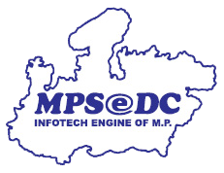
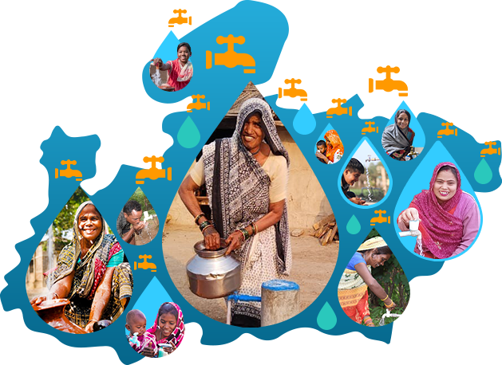
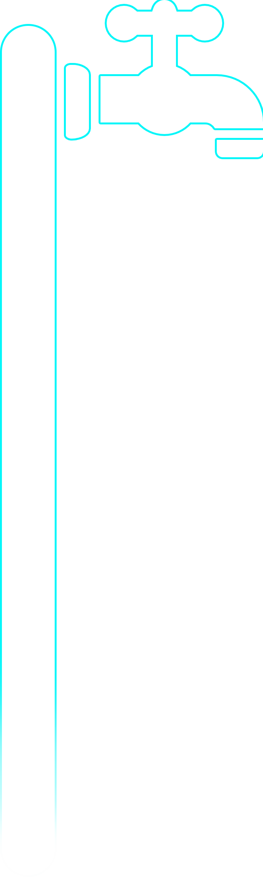

Jal Rekha
GIS-based Web & Mobile Application
1

Slide 2

Introduction
Jal Nigam is implementing various water supply schemes across Madhya Pradesh to ensure clean and safe drinking water reaches every village. To monitor these schemes efficiently, the department requires a robust GIS-based solution.
Jal Rekha is a comprehensive application developed to facilitate real-time monitoring and management of water supply infrastructure in both the execution and O&M phases. The solution comprises both a GIS-based Mobile App and a Web Application.
Mobile Application
Used for surveying and mapping water supply assets.
Captures pipeline details, photos, videos, and GPS coordinates.
Enables real-time data collection and progress tracking.
Web Application
Centralized platform for monitoring project activities.
Enables task assignment and workflow management.
Provides hierarchical tracking and
reporting.

Slide 3
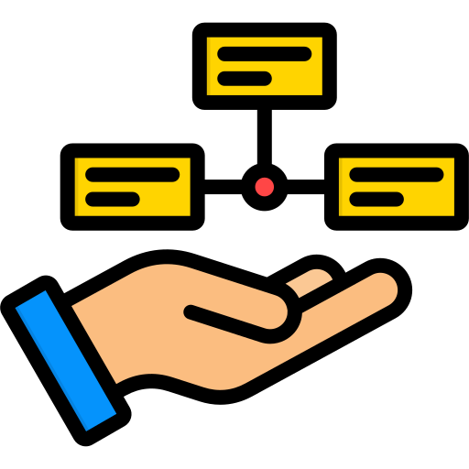
Key Features
Upload drawings of approved planned work as per DPR
Mapping assets across various schemes and capturing geo-tagged photos for effective asset management
Captures contractor commitments for planned start and planned completion dates of different components
Survey of the laid pipeline and other components through the mobile application
Analyzing planned and actual work with easy-to-use visualization tools to enhance monitoring and analysis capabilities
Streamline the submission, tracking, and resolution of RFIs (Request for Information)
Monitoring of water quantity & quality
Enable real-time monitoring of NGO social programs and initiatives.
Integration with SCADA (Supervisory Control and Data Acquisition) and PM Gati Shakti
Enables citizens to access water quality reports and raise grievances to ensure transparency

Slide 4

Current Status
01
Total Schemes – 147
06
Total RFI Generated Schemes – 112
02
Total Web Users – 755
07
Daily Inspection Count – 107946
03
Total Mobile Users – 4237
04
Total Contractor User – 287
05
Total No. RFI Raised – 213855

Slide 5
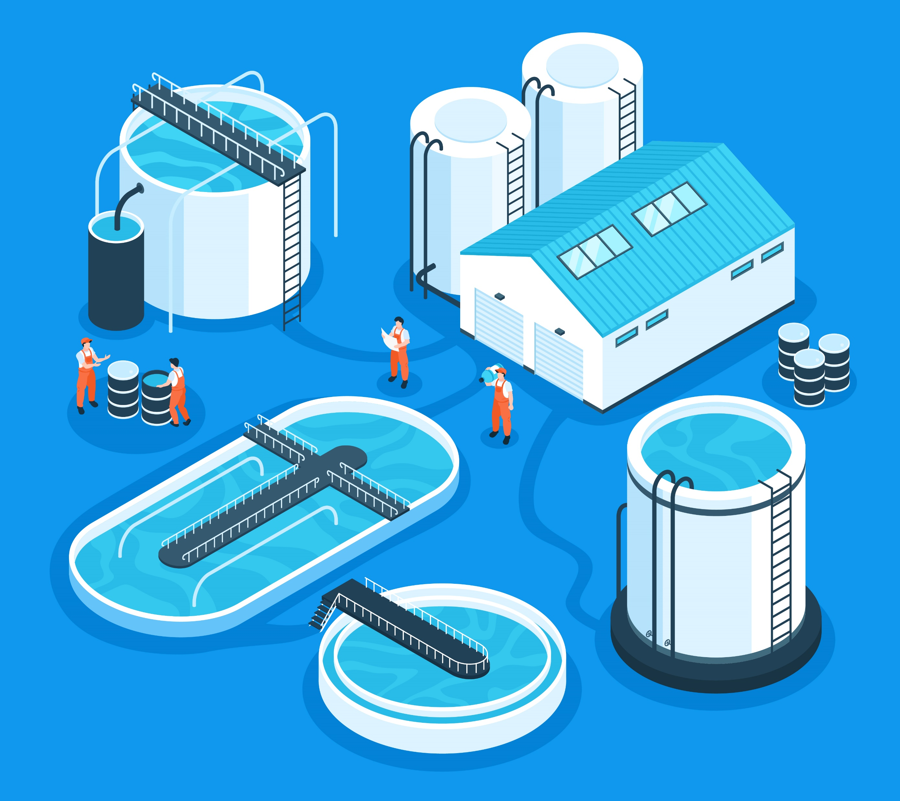
Current Status
08
Line Data
Total Proposed Pipeline – 2.07 Lakhs KMs
Proposed CWGM – 55500 KMs
Proposed CWPM – 12816 KMs
Proposed Distribution – 1.37 Lakhs KMs
Proposed RWPM – 731 KMs
Upload Pipeline – 2.02Lakhs KMs
Upload CWGM – 55000 KMs
Upload CWPM – 12000 KMs
Upload Distribution – 1.29 KMs
Upload RWPM – 700 KMs
Surveyed CWGM – 1.05 Lakhs KMs
Surveyed CWPM – 4800 KMs
Surveyed Distribution Line – 52000 KMs
Surveyed RWPM – 465 KMs
09
Point Data
Proposed Intake – 147
Proposed MVR – 271
Proposed WTP – 147
Proposed OHT – 11349
Upload Intake – 120
Upload MBR – 256
Upload WTP- 124
Upload OHT – 11264
Surveyed Intake – 105
Surveyed MBR – 150
Surveyed WTP – 118
Surveyed OHT – 11235

Slide 6
Jal Rekha – Modules Status
S No | Module | Description | Status
1 | User Role Management | Enables role-based access control, allowing administrators to define and manage user permissions for modules , monitoring, task assignment, and reporting | Completed
2 | Asset Mapping | Users can map assets/Component Point data (Intake well, OHT, BPT,WTP etc.) across different schemes and capture geo-tagged photographs associated with these components | Completed
3 | Traverse functionality | The Traverse functionality enables users to move through the pipeline like CWGM, CWPM, Distribution Pipe and RWPM. | Completed
4 | Geofencing | All map/traverse data has been geofenced for inspections. | Completed
5 | Anusharvan - RFI (Request for Inspection) | Work Monitoring Module have two module Inspection request (RFI) and Inspection History. | Completed
6 | Anusharvan - Daily Inspection | End to end module for reporting, monitoring, approval and notification | Completed

Slide 7
Jal Rekha – Modules Status
S No | Module | Description | Status
7 | Dhara for Quantity of water | The Dhara Module under the Jal Nigam's scheme ensures continuous monitoring and maintenance of water quality across various regions. | Completed & Updation
8 | Sahbhagita | To monitor the social activities performed by the NGOs | Completed
9 | Nirmal for Quality of water | Ensures water quality in various schemes for safe drinking water. Conducts regular tests to detect contaminants or pollutants. | Completed
10 | Sopan | enables contractors to commit to start and completion dates for OHT construction, allowing the department to monitor progress and ensure timely project delivery. | Completed & Updation
11 | Jal Samadhan | This module allows citizens to report issues related to water leakage, water quality, the regularity of water supply, pressure, and other concerns. | Requirement Gathering
12 | O&M Billing | This module simplifies the water supply billing process for the department by directly fetching quantity data from Dhara and quality data from Nirmal. It enhances efficiency while reducing manual effort. | Requirement Gathering

Slide 8
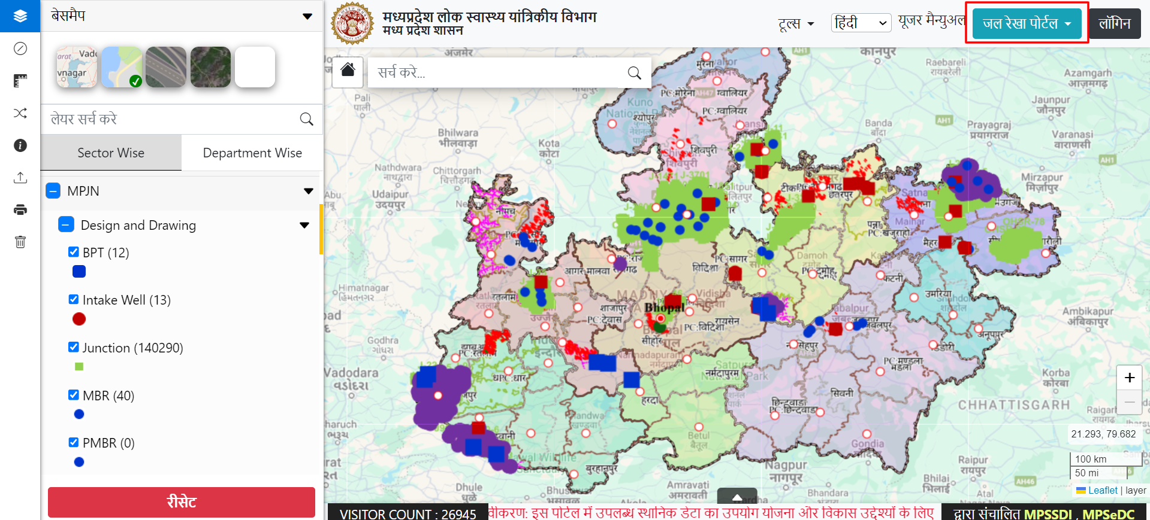
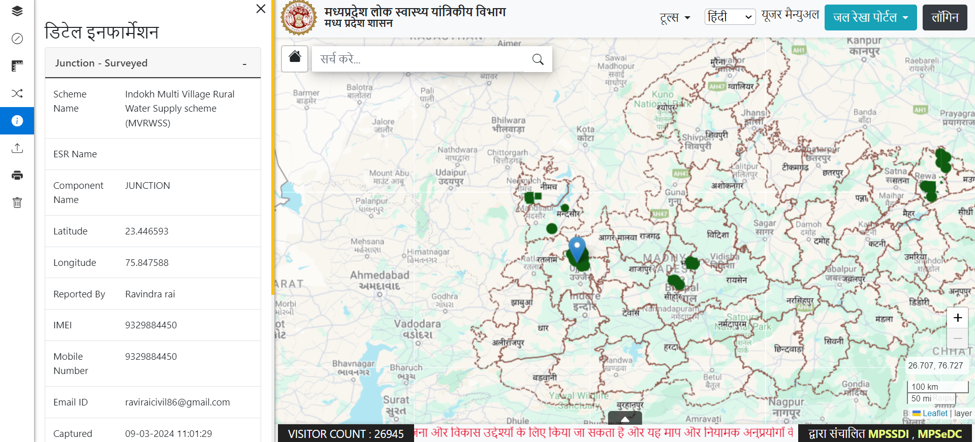
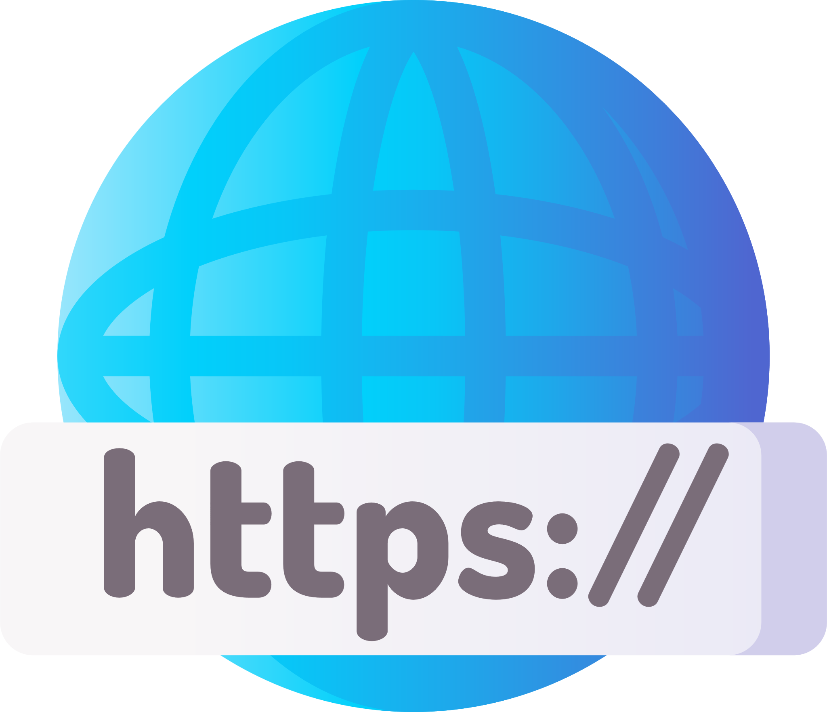

Web Application
Department Login: Department users access the web application using authorized login credentials. They enter their username, password, and captcha on the login page, then click Login to authenticate and securely perform their tasks
Upload Proposed drawing KML of Schemes with Components: PIU users can upload planned KML files for detailed mapping and visualization of schemes with associated components
Display Proposed and Actual Data: The portal displays proposed scheme data and field surveyed actual data on separate layers, enabling visualization and analysis of actual and planned
Uploaded Schemes Data
Field Surveyed Data Information
geoportal.mp.gov.in/MPPHE

Slide 9

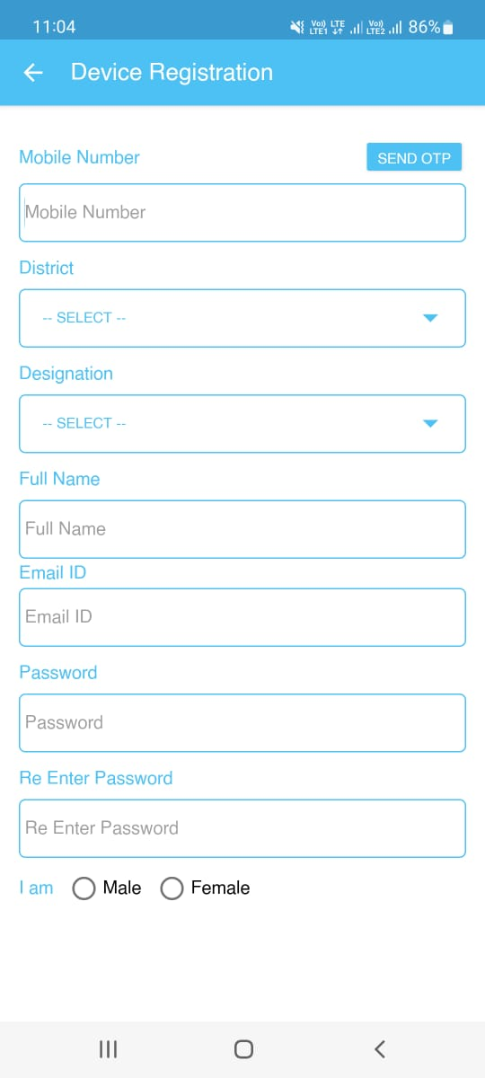
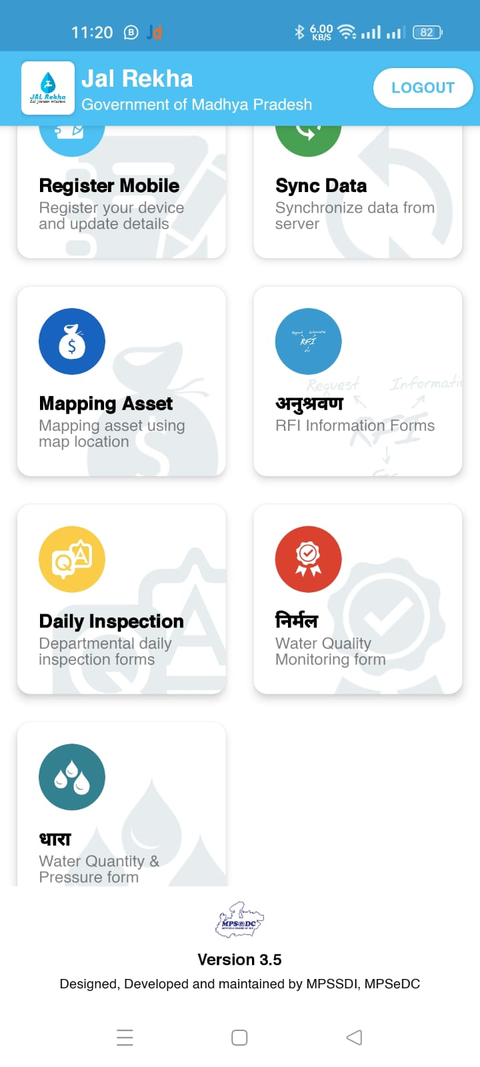
Jal Rekha Mobile Application
Device Registration: Users can register their Android smartphones by completing a registration form within the app. This process allows users to obtain authorization from the administrator.
Sync Data: This feature enables users to synchronize assigned schemes & Components between their device and the server, ensuring that the most up-to-date assigned work is available to the user.
Mapping Asset: Users can map assets across different schemes and capture geo-tagged photographs associated with these components, helping them to effectively manage and track assets.
Geofencing for data updation/ Upload Asset: After mapping assets, users can upload the information to the server, ensuring that the asset data is stored centrally and accessible to authorized users as needed.
9
Mobile App https://play.google.com/store/apps/details?id=mapitgis.jalnigam.release

Slide 10
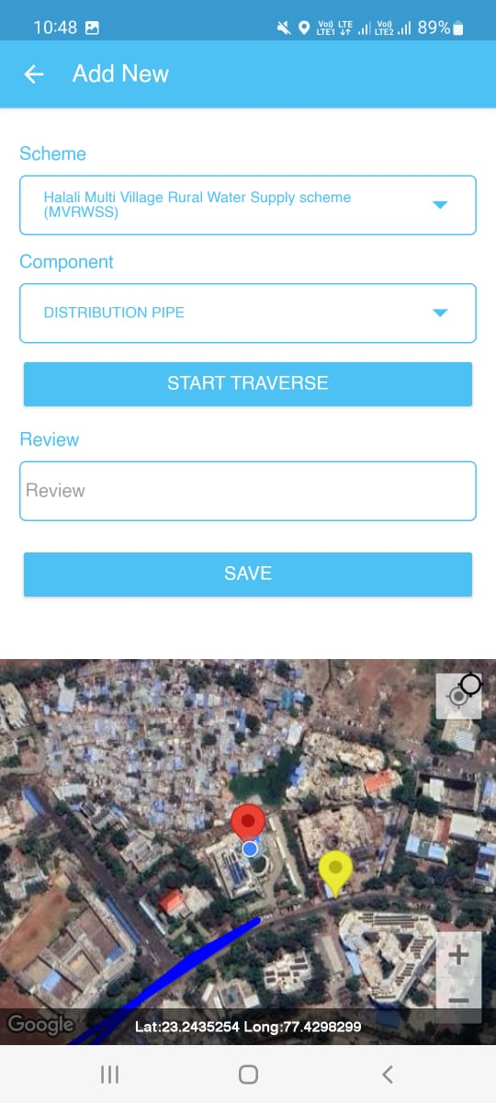
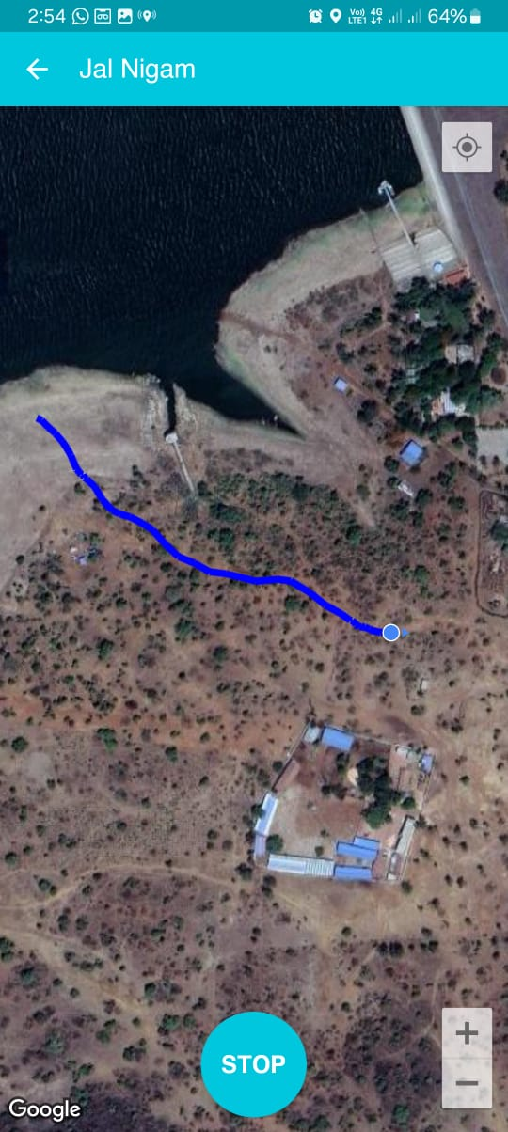
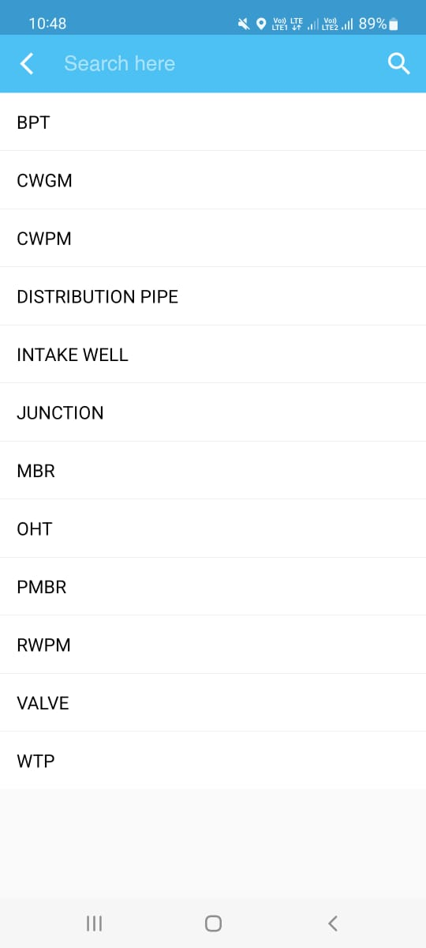
Traverse in Mapping Asset
The Traverse functionality enables users to move through the data and explore different attributes (CWGM, CWPM, Distribution Pipe and RWPM, or spatial locations. The scheme and ESR name fields are pre-filled and assigned by the PIU. Users can select a component from a dropdown menu, click a photo, enter a review, and save the location. The app can access the user's location after registration.
10

Slide 11
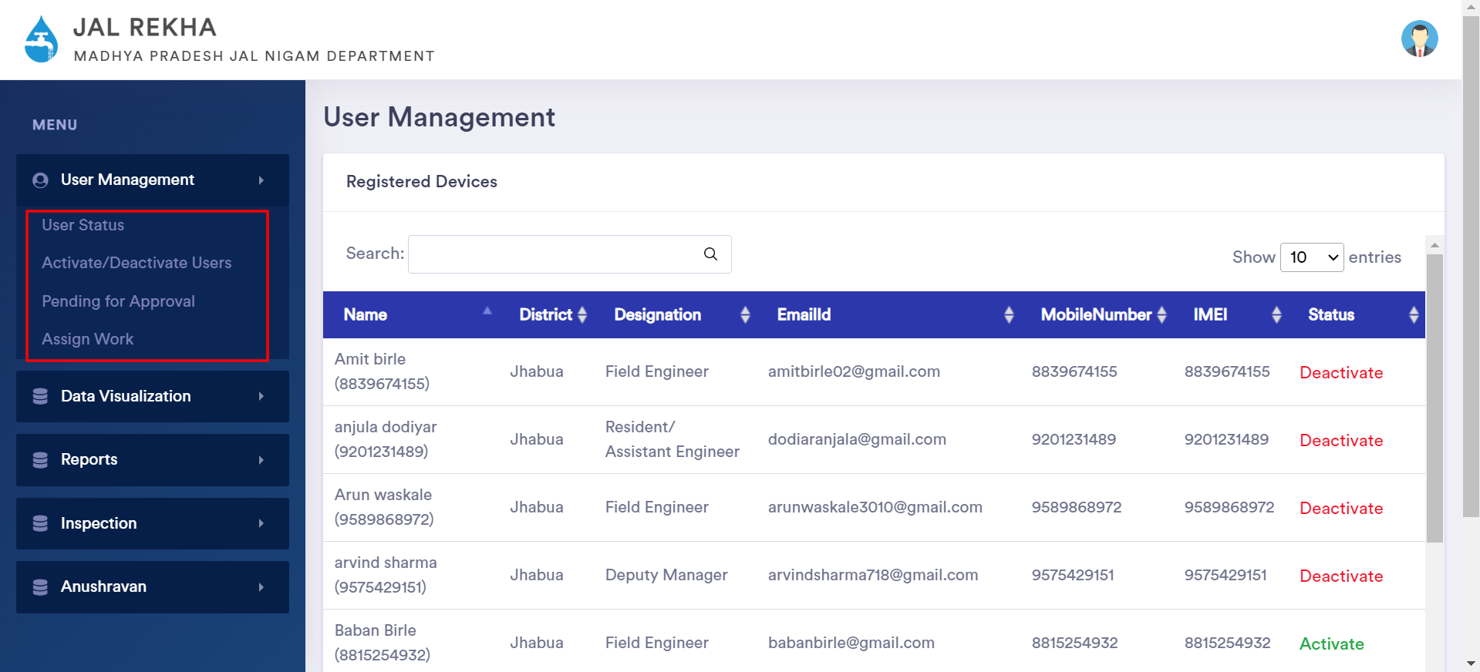
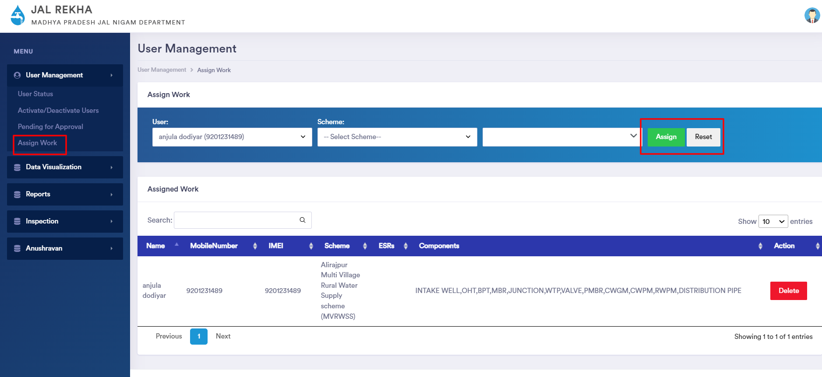
Web Application
1. User Role Management:
The User Role Management module in Jal Rekha empowers Admin or GM PIU to efficiently manage user access and permissions. It allows them to add, edit, and update user details, ensuring that each user is appropriately assigned to specific schemes based on their role. Additionally, administrators can define user rights, granting controlled access to modules, data, and reports as per their responsibilities.

Slide 12


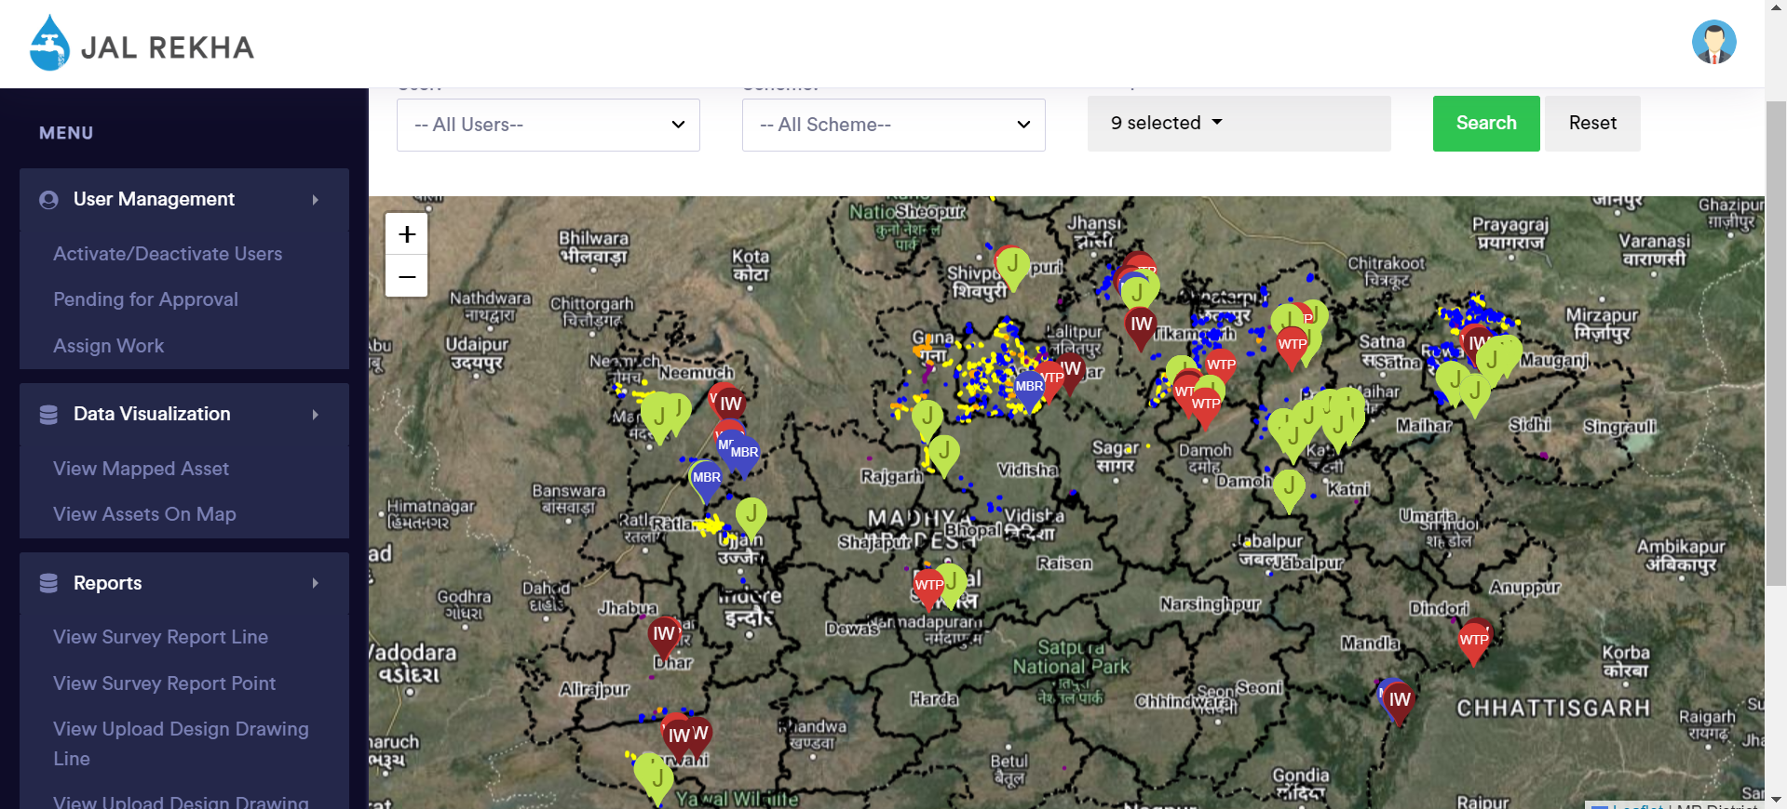
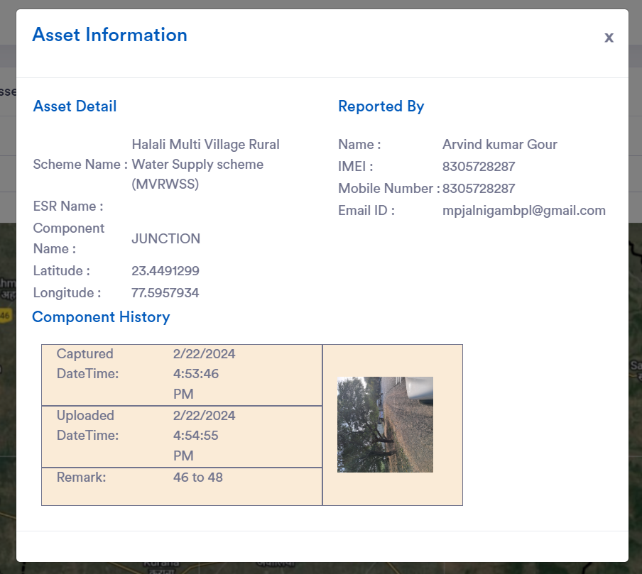
Web Application
Data Visualization: User can visualize the data on map and filter/search Assets By User Name, Scheme, ESR, Component.

Slide 13
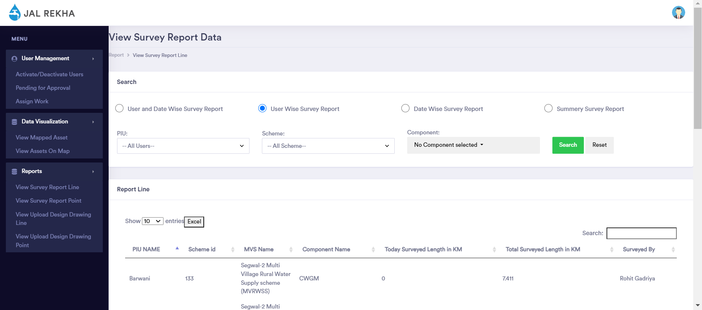
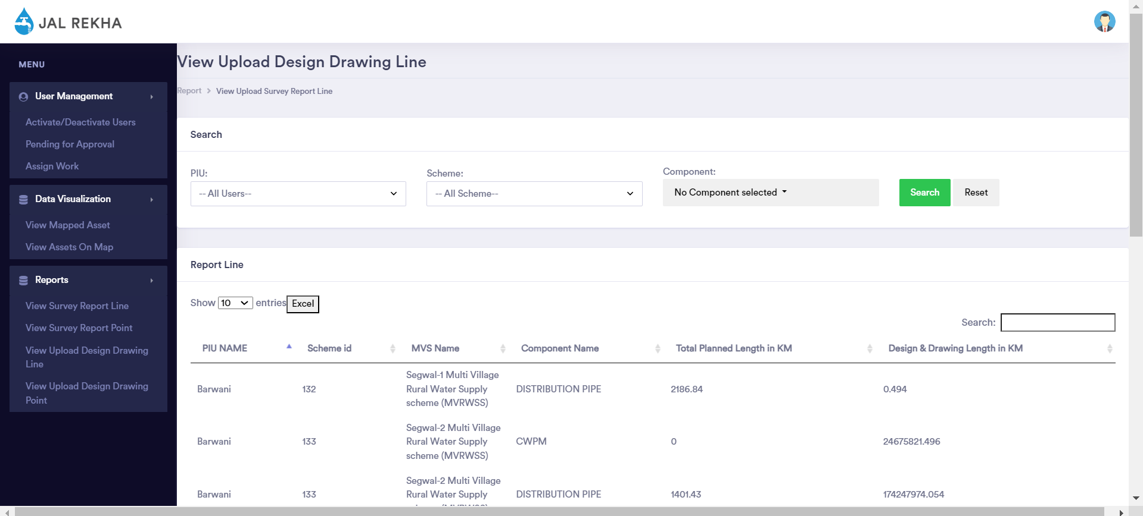
Web Application
Reporting: Generate detailed reports based on various parameters. Provides insights into Asset Survey and Upload Design & Drawing Data progress .

Slide 14
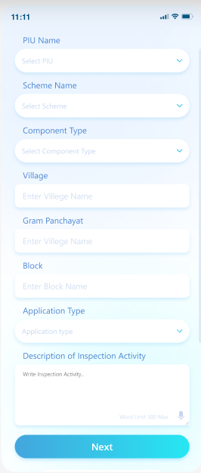
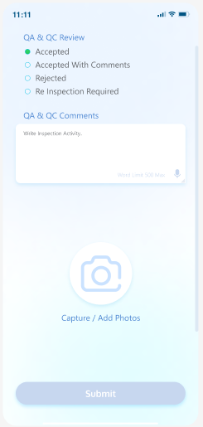
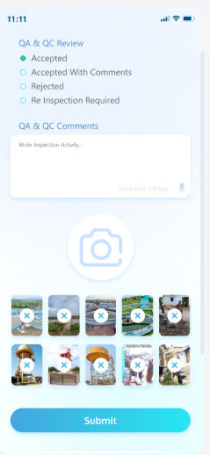
Jal Rekha Mobile Application -Daily Inspection Module
Daily Inspection: The Inspection Module for the Jal Nigam Ongoing Scheme is designed to enhance the oversight of work quality and materials used by contractors. Field engineers from the department will perform inspections and submit their reports. Concerned authorities within the department will review these reports and take appropriate actions based on the findings.
14

Slide 15
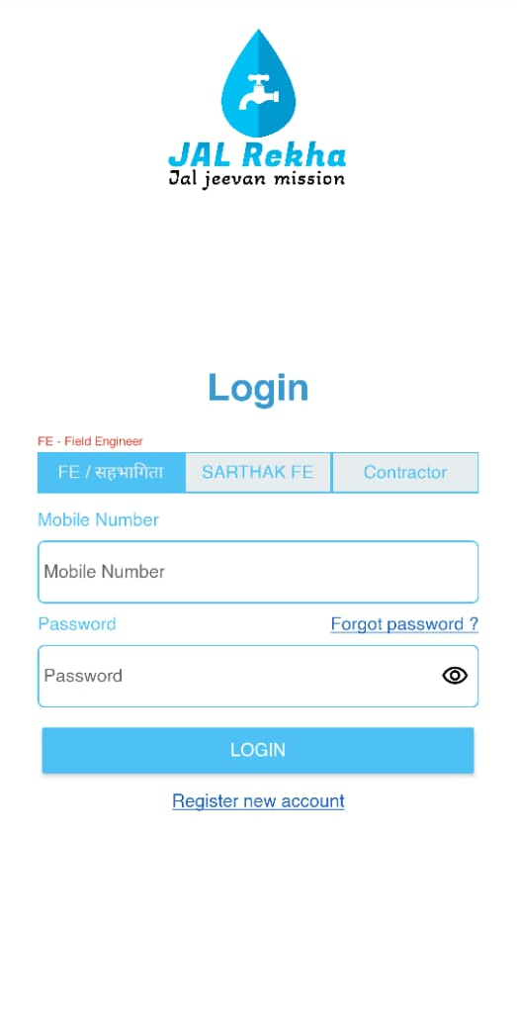
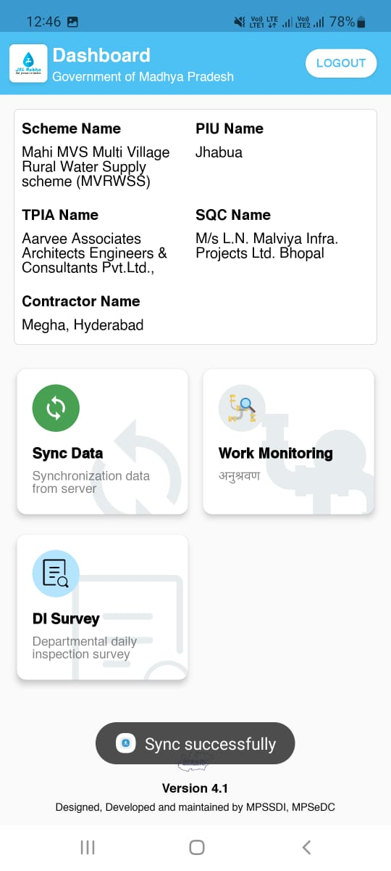
Jal Rekha Mobile Application – Work Monitoring/अनुश्रवण
Contractor
Contractor Login: Users can register their Android smartphones by completing a registration form within the app. This process allows users to obtain authorization from the administrator.
Sync Data: This feature enables users to synchronize assigned schemes & Components between their device and the server, ensuring that the most up-to-date assigned work is available to the user.
Work Monitoring/अनुश्रवण : Work Monitoring Module for the Jal Nigam Scheme is designed to enhance the inspection process, ensuring thorough oversight and efficiency. Work Monitoring Module have two module Inspection request and Inspection History.
15

Slide 16
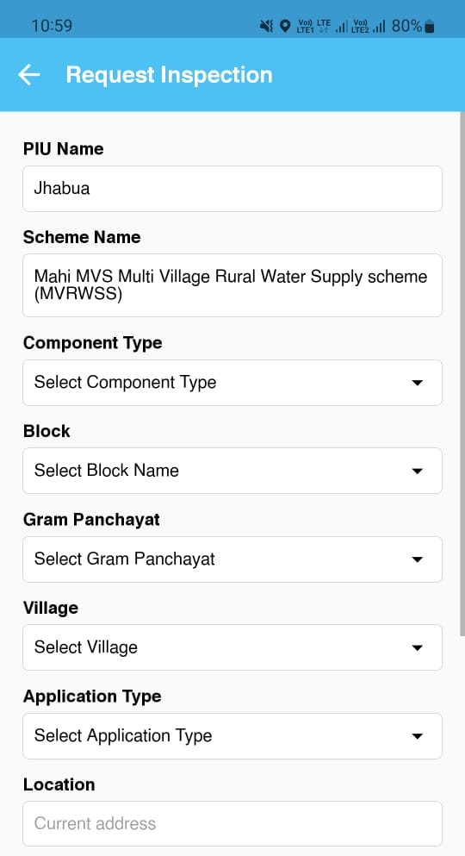
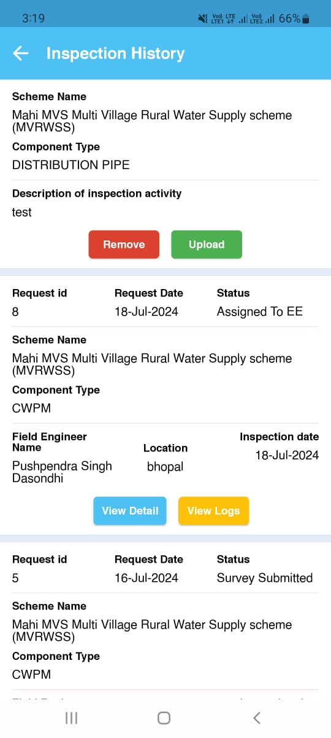
Jal Rekha Mobile Application – Work Monitoring/अनुश्रवण
Contractor
Inspection Request - RFI(Request for Inspection): Users can submit inspection requests for various Jal Nigam schemes, providing necessary details and supporting images. Contractor receive real-time notifications about their inspection request status, including acknowledgment of RFI, inspection scheduling, and completion reports.
Inspection History: In the Request History section, users can view the history of their Requests for Inspection (RFI) and have the option to request a revisit. This feature allows users to track past submissions and manage follow-up actions efficiently.

Slide 17
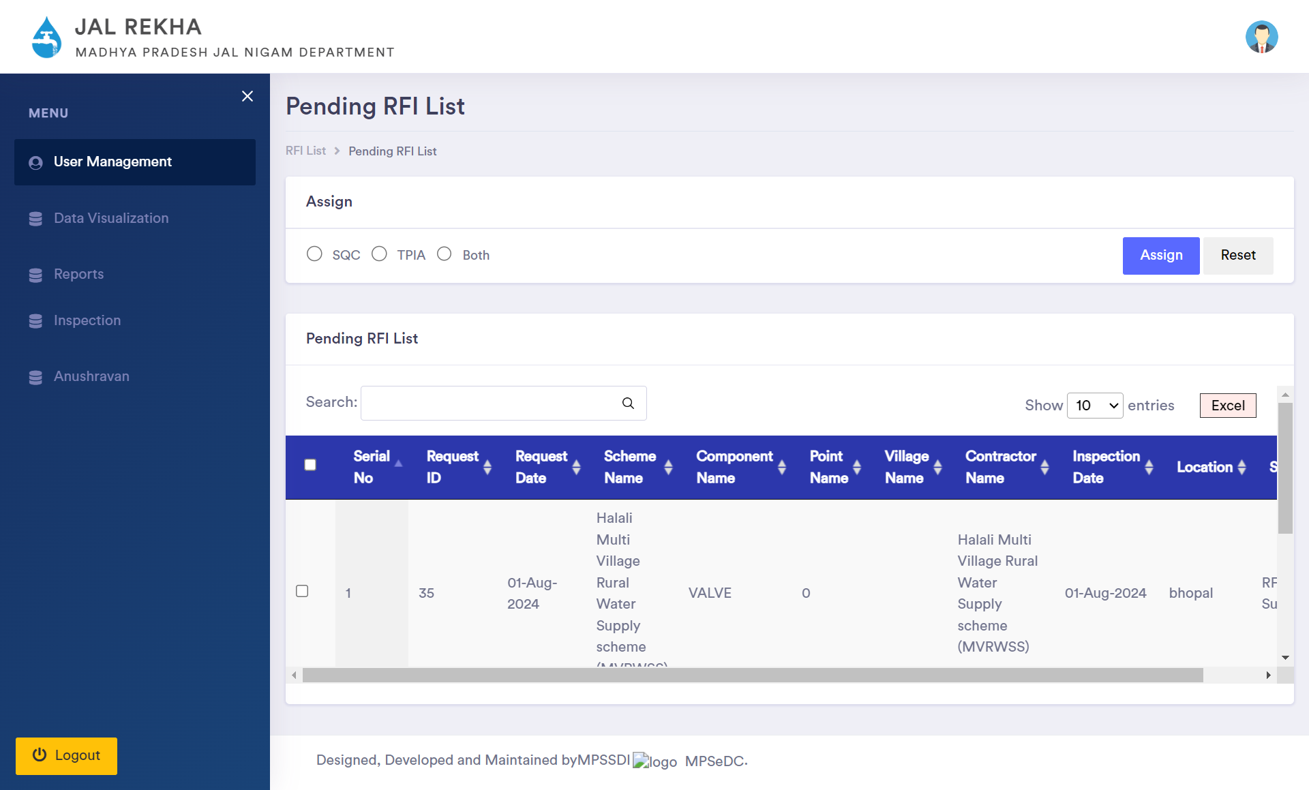
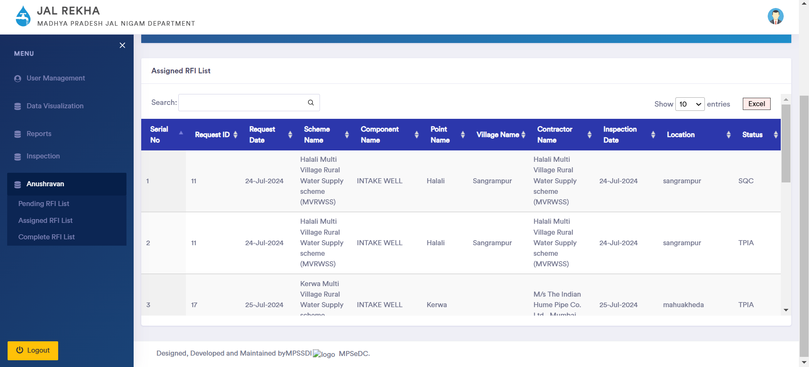
Jal Rekha Mobile Application – Work Monitoring/अनुश्रवण
PIU GM User
Pending RFI List: Upon receiving an inspection request from the contractor, the PIU will review the details and then assign the inspection task to either the SQC or TPIA, ensuring that the appropriate entity handles the inspection process.
Assigned RFI List: The PIU can view their assigned inspection list and track the progress of each inspection. If a revisit is required, the PIU can reassign the task to the SQC or TPIA. This functionality ensures efficient monitoring and follow-up on inspections, maintaining the workflow and ensuring all inspections are thoroughly completed.

Slide 18
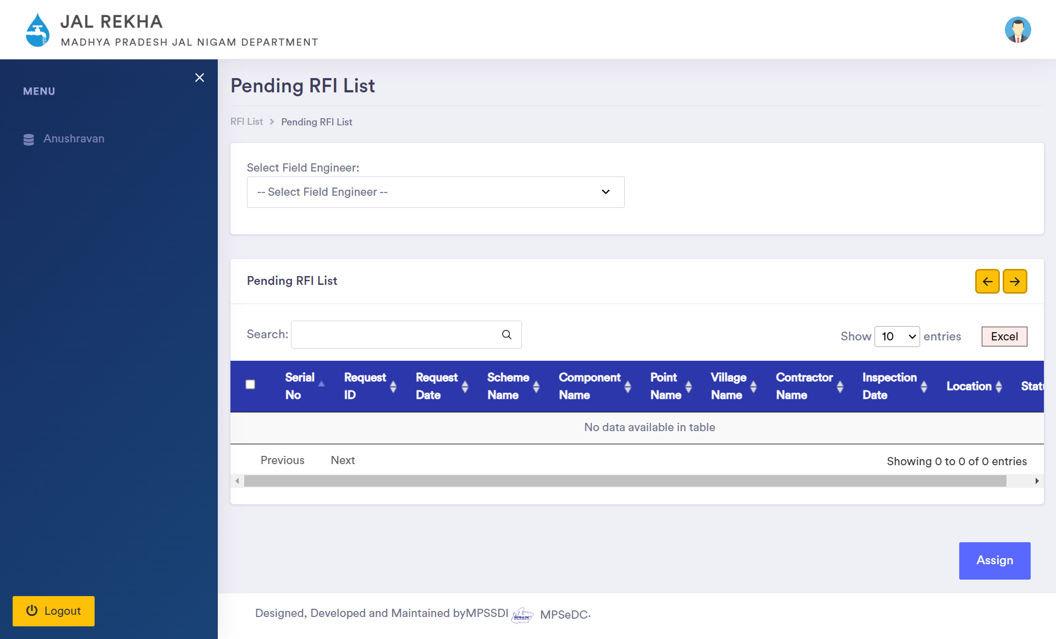
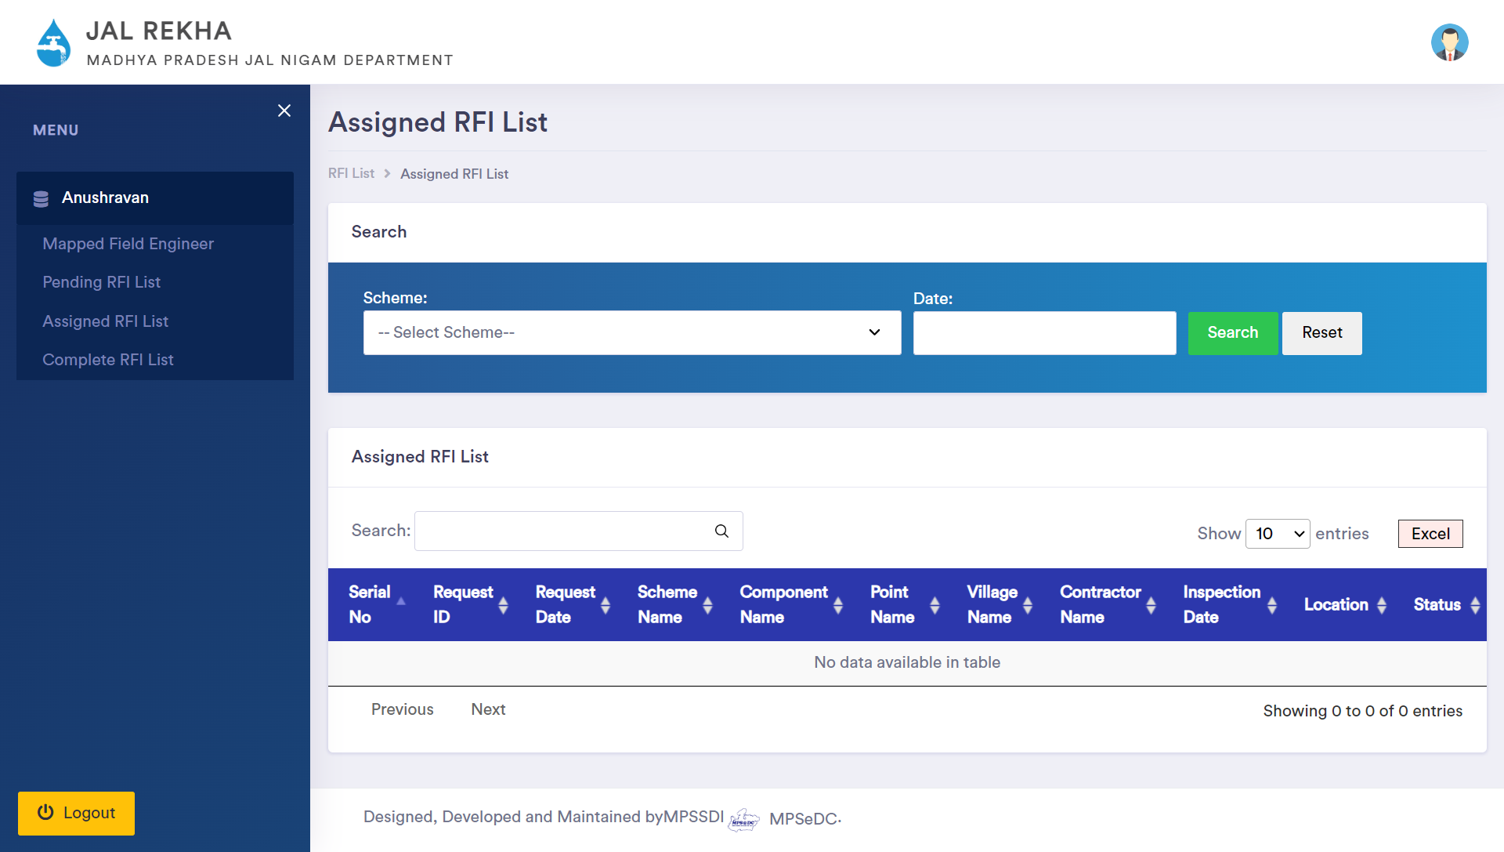
Jal Rekha Mobile Application – Work Monitoring/अनुश्रवण
SQC/TPIA
Pending RFI List: Inspection RFIs assigned by the PIU. SQC, or TPIA will enable users to view the details of the inspection request and assign it to the appropriate field engineer. This efficient process ensures that inspection tasks are delegated and managed effectively, facilitating timely and accurate field operations.
Assigned RFI List: The Supervisory Quality Control (SQC) or Third-Party Inspection Agency (TPIA) will be able to access the assigned inspection list and monitor the progress of inspections. If there is a request to assign a task, they have the authority to assign the task back to the field engineer responsible for conducting the inspection.
18

Slide 19
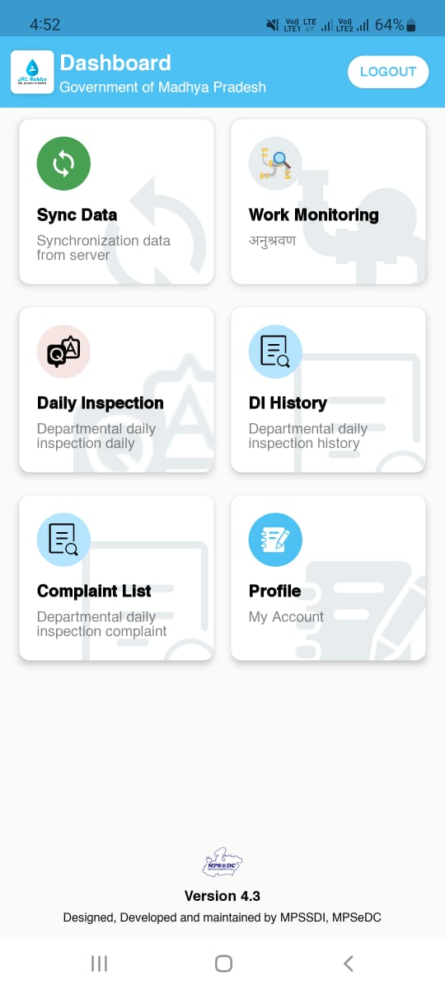
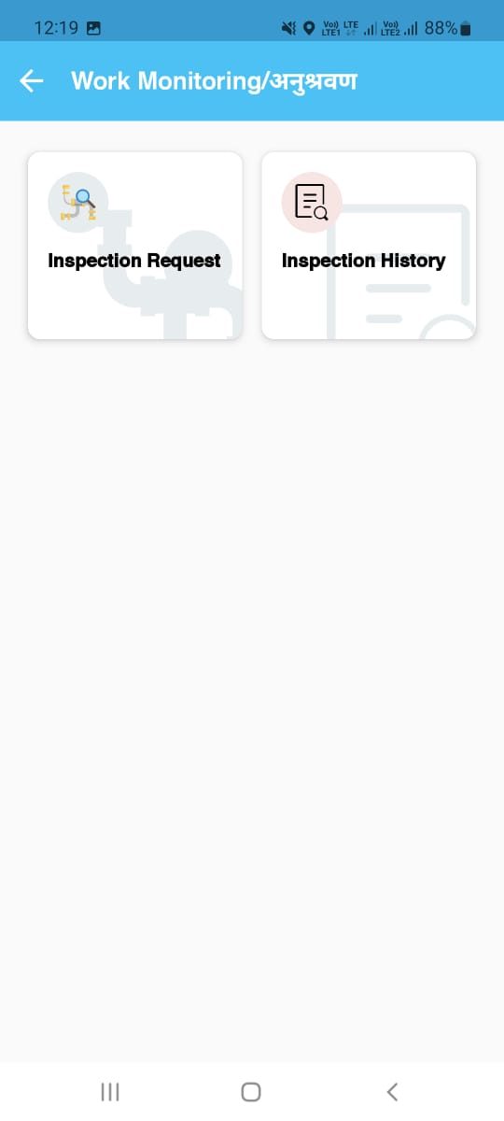
Jal Rekha Mobile Application – Work Monitoring/अनुश्रवण
Device Registration: Users can register their Android smartphones by completing a registration form within the app. This process allows users to obtain authorization from the administrator.
Login: Users can register their Android smartphones by completing a registration form within the app. This process allows users to obtain authorization from the administrator.
Sync Data: This feature enables users to synchronize assigned schemes & Components between their device and the server, ensuring that the most up-to-date assigned work is available to the user.
Work Monitoring/अनुश्रवण :Work Monitoring system for the Jal Nigam Scheme is designed to enhance the inspection process, ensuring thorough oversight and efficiency. Work Monitoring Module have two module Inspection request and Inspection History.
19

Slide 20
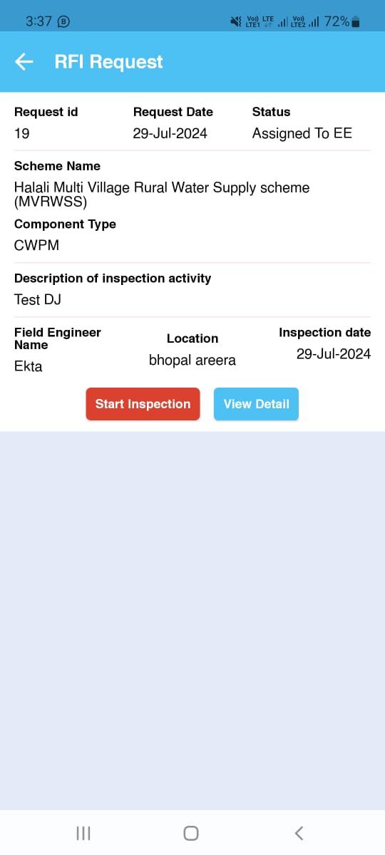
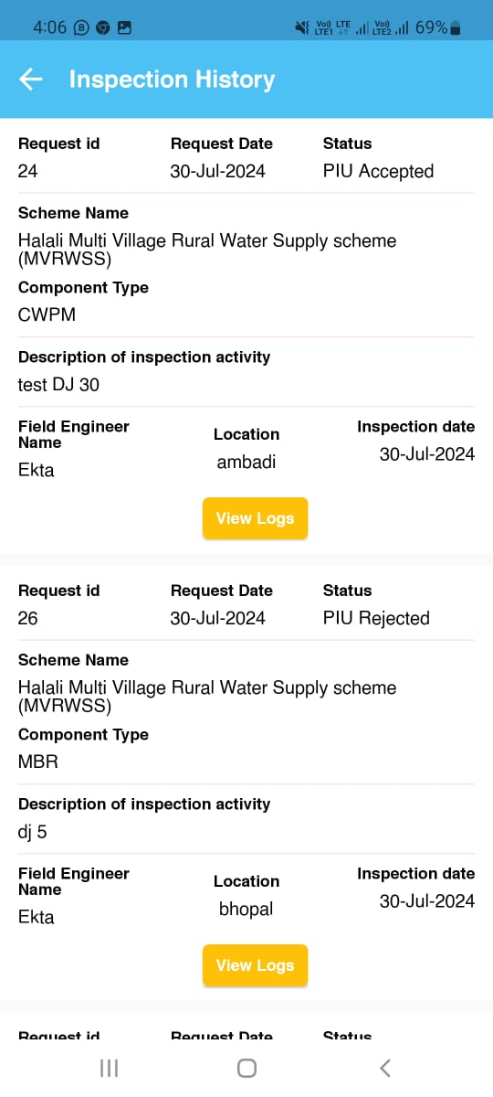
Jal Rekha Mobile Application – Work Monitoring/अनुश्रवण
5. Inspection Request: Field engineers have the option to assign inspections to either the SQC or TPAI. Once assigned, the field engineer conducts the inspection and provides their observations and inputs through the app interface. After completing the inspection, the field engineer submits the report through the app. The system then automatically forwards the submitted report to the relevant PIU (Project Implementation Unit) for further action and review.
6. Inspection History: the Request History section, users can view the history of their Requests for Inspection (RFI) and have the option to request a revisit. This feature allows users to track past submissions and manage follow-up actions efficiently.
20

Slide 21

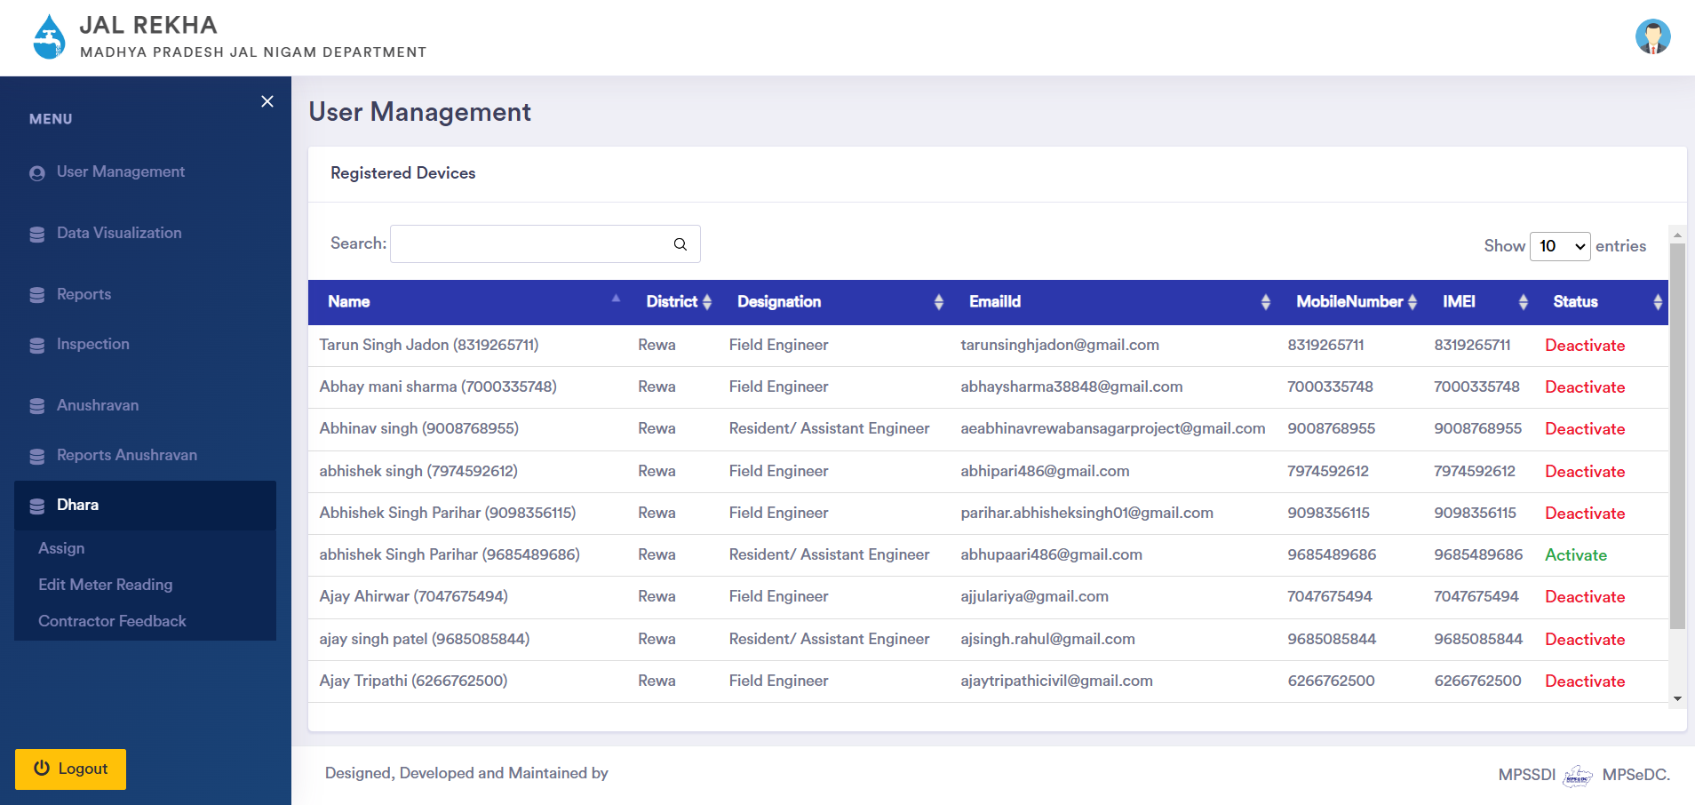
Jal Rekha Web Application – Dhara
Dhara: This module has been developed to monitor the water supplied through various components (Intake/WTP/OHT) of the scheme, which will further be used for billing purposes of contractors. Assigned field engineers upload the meter readings of these components daily, and these readings shall be verified by the Team Leader, followed by the GM.
Assigning Component : GM shall assign the component to filed engineers/ assistant engineers to upload meter reading.
Verification/Approval of Meter Readings: Reading uploaded by field engineers or assistant engineers shall be verify by team leader and forwarded to GM for final approval. Once approved by GM, its shall be visible to contractor.
Contractor: Contractor shall able to check the daily meter reading approved and in case of any clarification, contractor shall raise the query to GM.

Slide 22
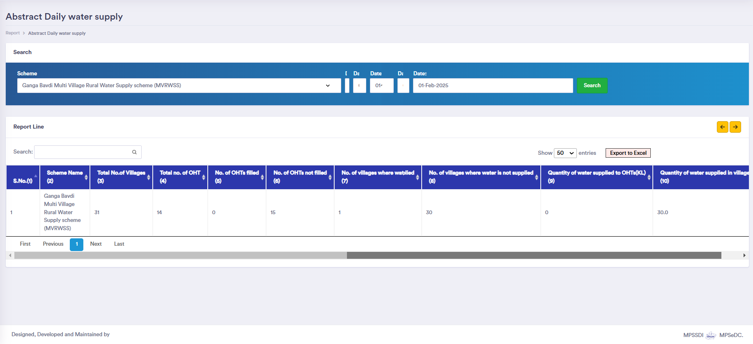
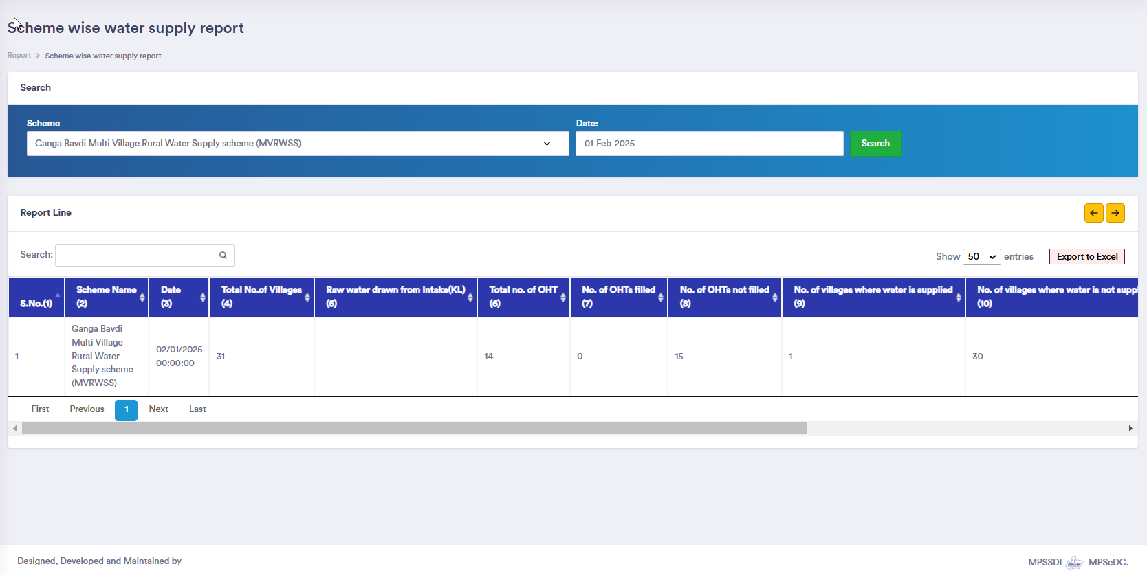
Jal Rekha Web Application – Dhara Reports
Daily Water Supply Report – This report captures real-time data on the daily water supply across different component covered under the schemes.
Scheme-wise Water Supply Report – This report consolidates data for water distribution across different schemes.

Slide 23
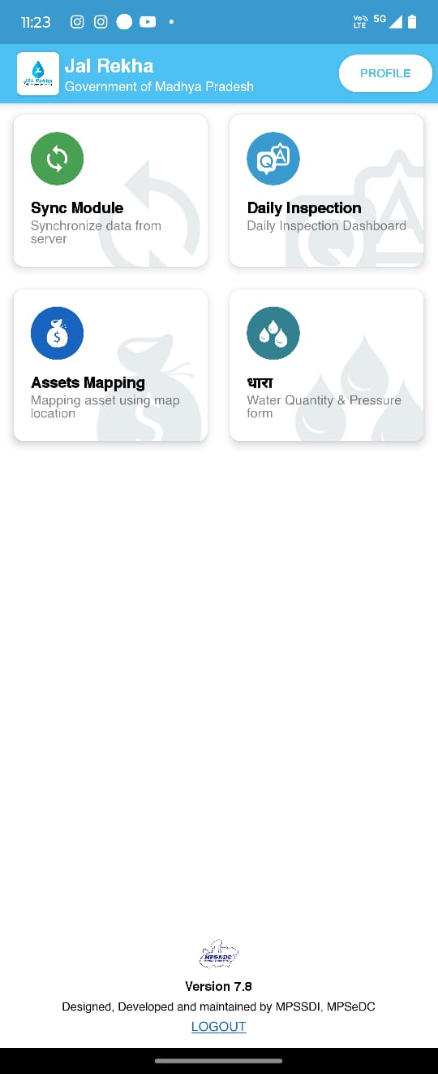
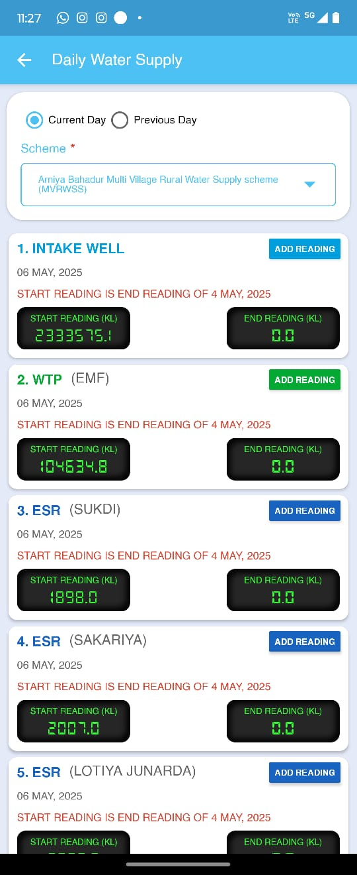
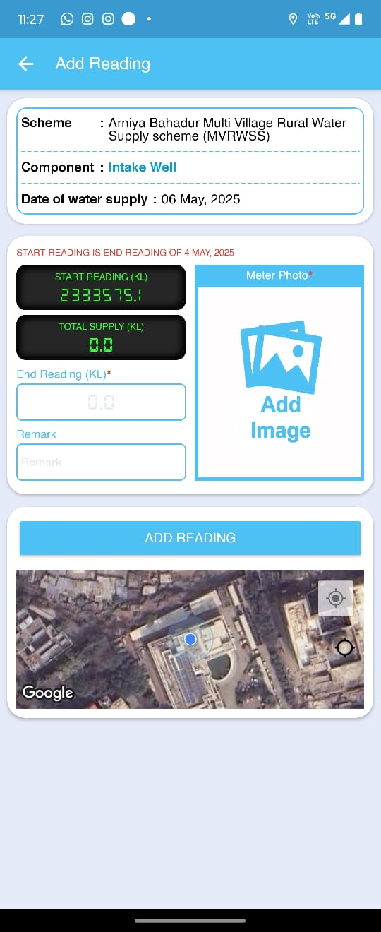
Jal Rekha Mobile Application – Dhara
Upload Meter Reading: Filed engineer shall able to view the components assigned by GM. Daily field engineers need to enter the meter reading and upload the photos of the meter.
23

Slide 24
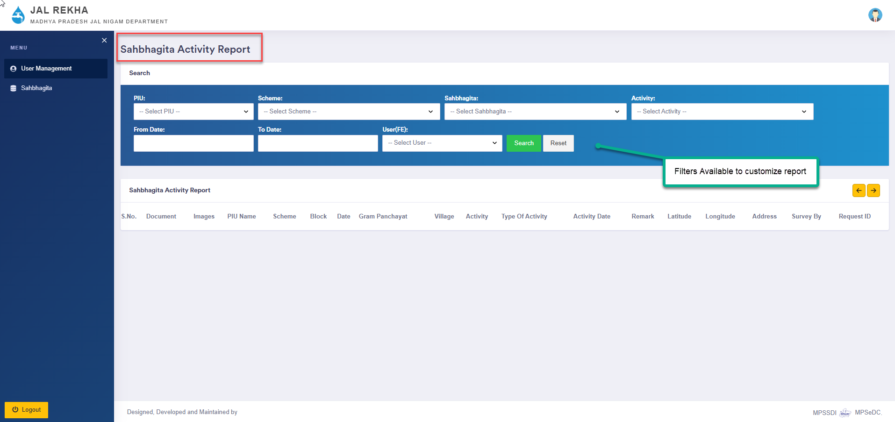
Jal Rekha Web Application – Sahbhagita
Sahbhagita -This module has been developed to monitor social activities conducted at the village level as part of the IEC (Information, Education, and Communication) initiatives for water supply schemes. The Project Manager/Coordinator assigns tasks to Community Mobilizers, who carry out awareness campaigns, training sessions, and community engagement activities using the mobile application.
Adding Project Manager/Project Coordinator: The GM shall add the Project Manager/Project Coordinator to the system and assign project-related tasks to them.
Assigning Work to Community Mobilizer: The Project Manager/Project Coordinator shall add Community Mobilizers and assign specific field activities to them.
Execution of Activities: The Community Mobilizer shall perform assigned activities using the mobile application, ensuring data collection and field execution as per the assigned tasks.

Slide 25
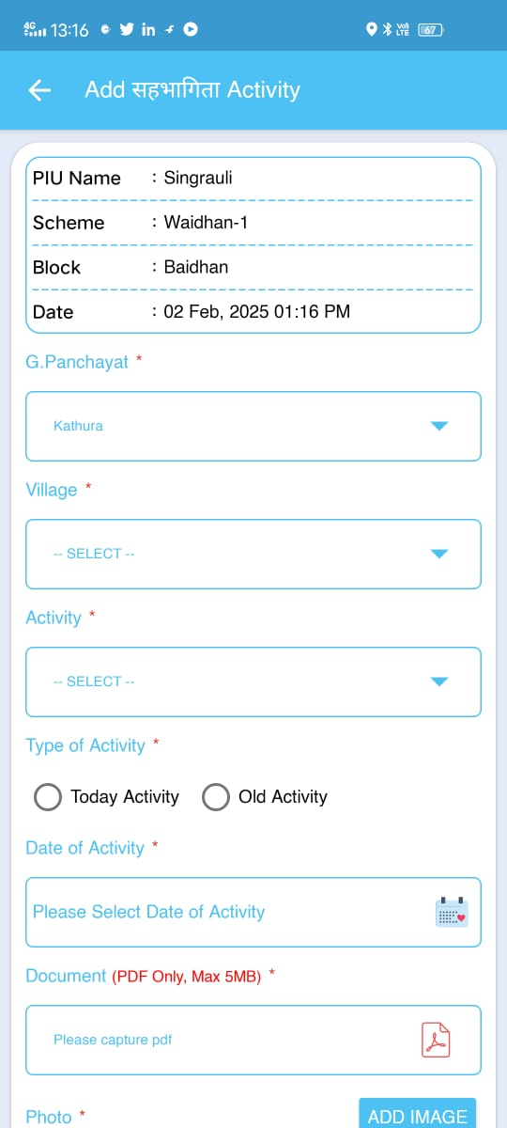
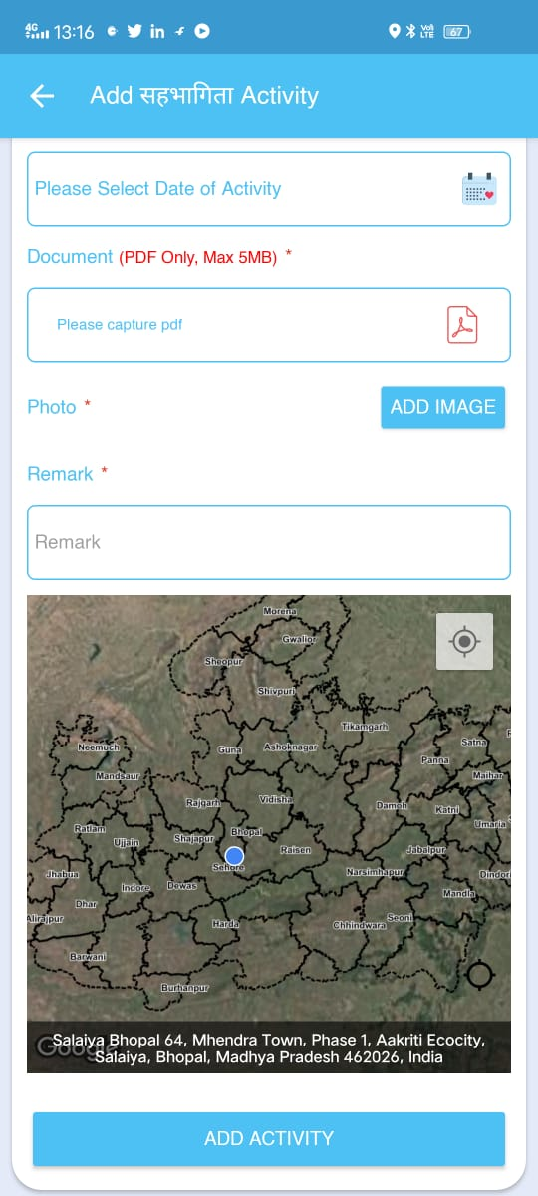
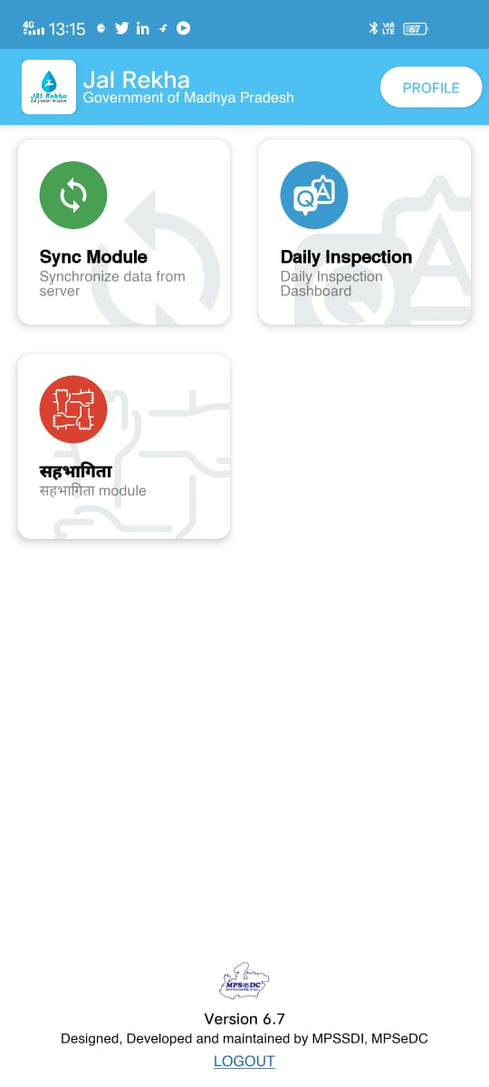
Jal Rekha Mobile Application – Sahbhagita
25

Slide 26
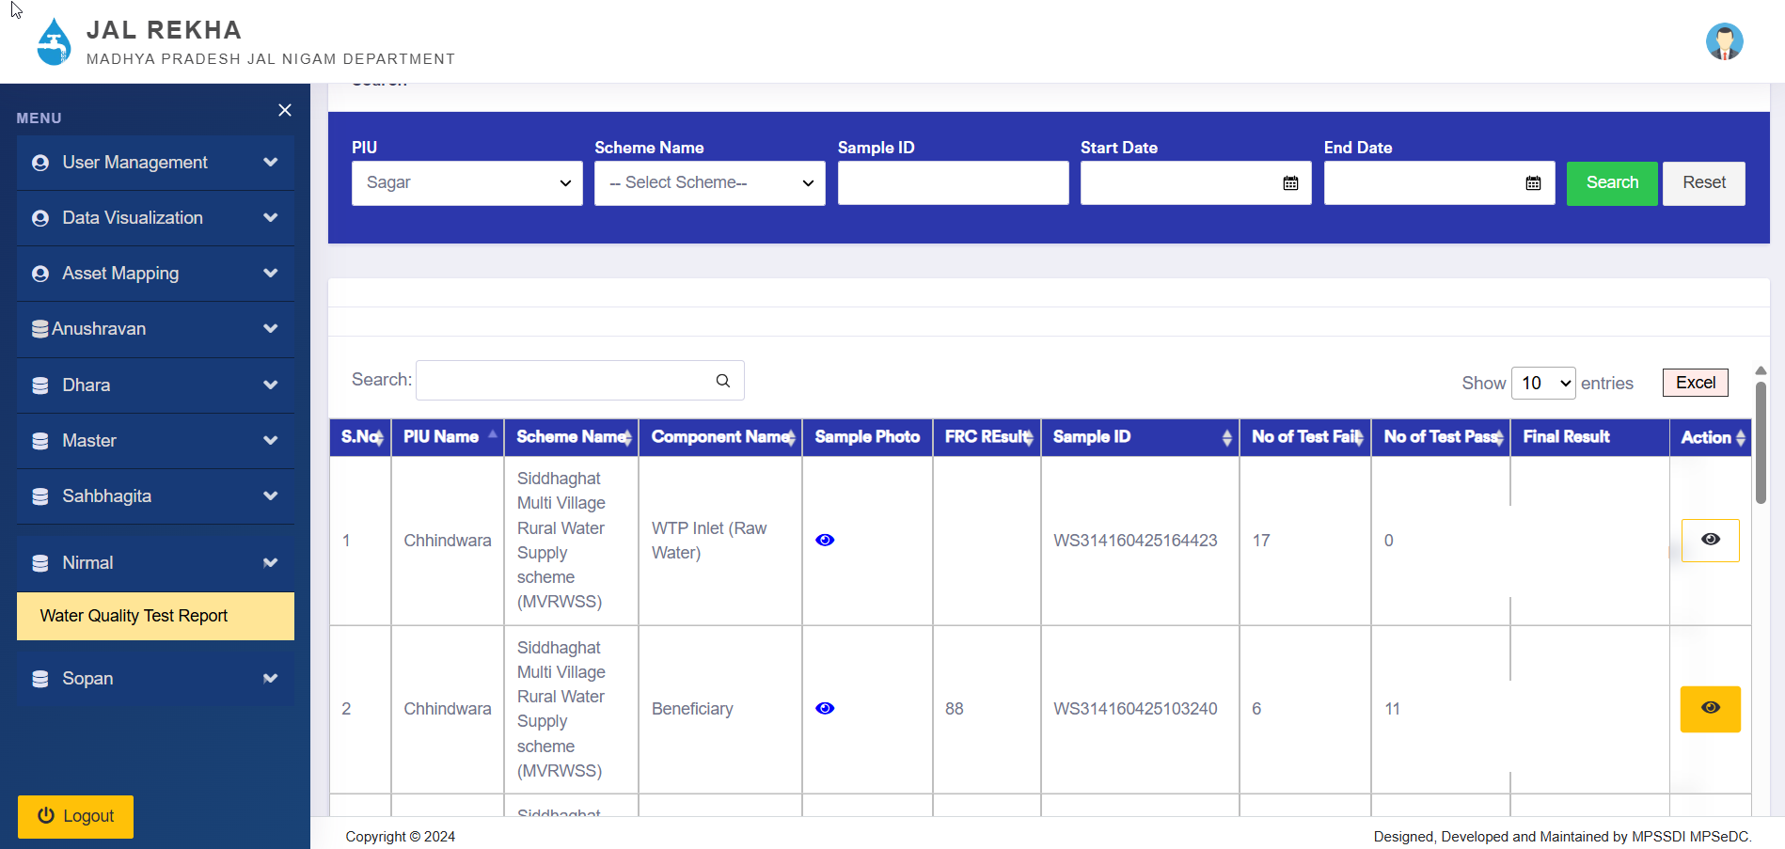
Jal Rekha – Nirmal
Nirmal - Nirmal is a dedicated module in Jal Rekha for water quality monitoring. Field engineers collect water samples and send them to the contractor for lab testing. Lab reports are uploaded in the system, enabling quality tracking, alert generation, and transparent sharing of results with citizens to ensure safe drinking water
Field Engineer: Collects water samples from assigned components (WTP – Inlet, WTP – Outlet, OHTs) and from beneficiaries, performs the FRC test, and uploads the images and results in the mobile application. The samples are then sent to the contractor’s lab for further testing.
Contractor: Conducts testing on the samples for 17 predefined parameters and enters the results for each parameter into the portal. These reports are made available to all portal users.

Slide 27
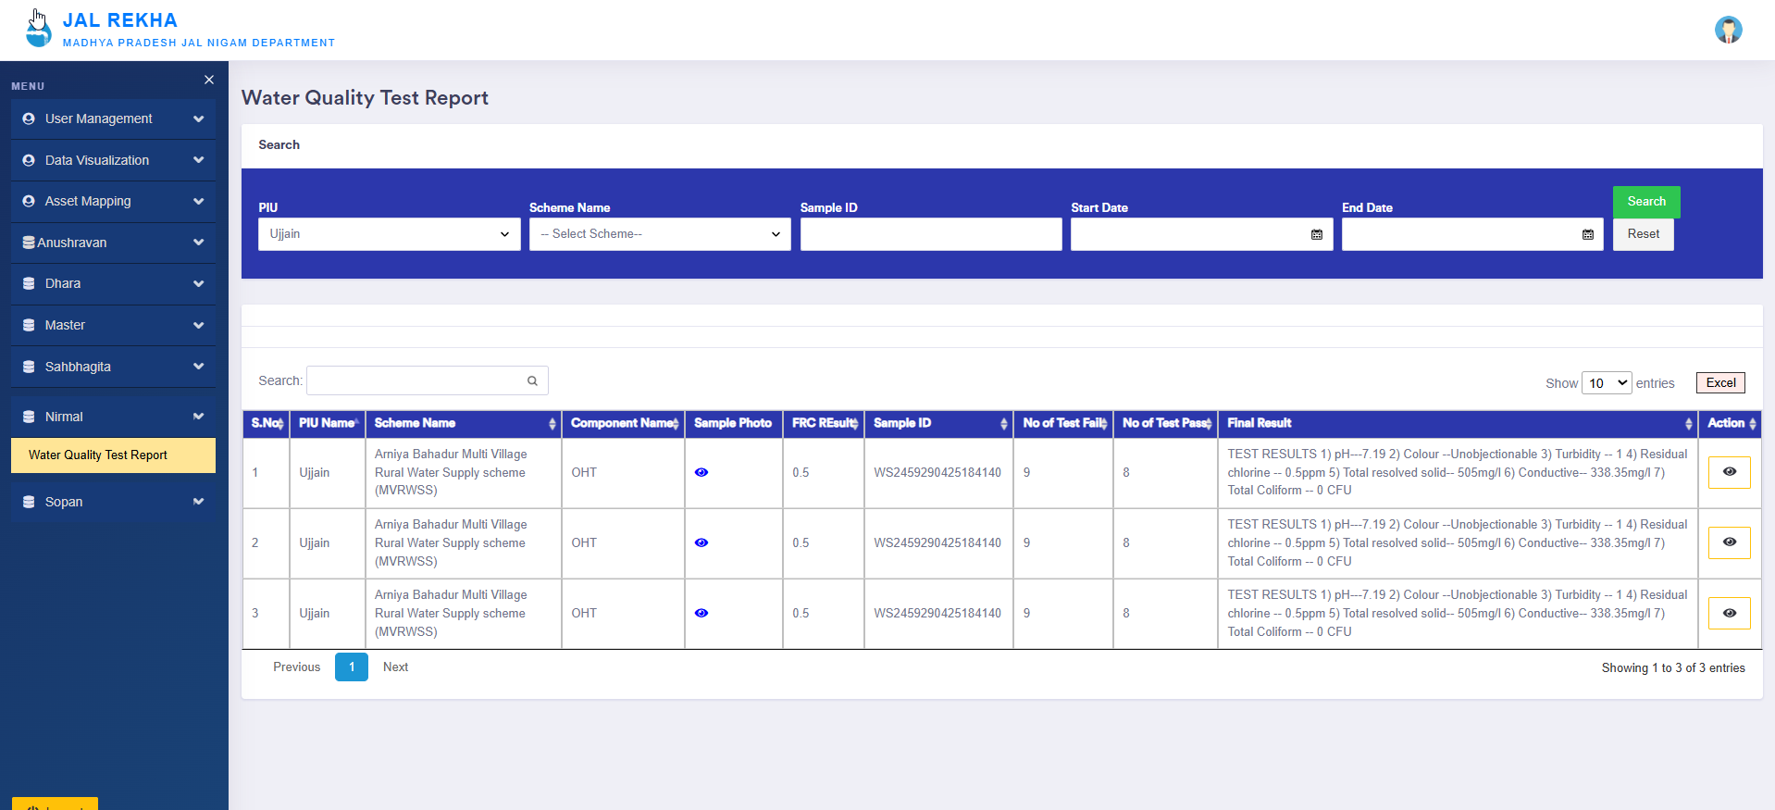
Jal Rekha – Nirmal
Nirmal - Nirmal is a dedicated module in Jal Rekha for water quality monitoring. Field engineers collect water samples and send them to the contractor for lab testing. Lab reports are uploaded in the system, enabling quality tracking, alert generation, and transparent sharing of results with citizens to ensure safe drinking water
Field Engineer: Collects water samples from assigned components (WTP – Inlet, WTP – Outlet, OHTs) and from beneficiaries, performs the FRC test, and uploads the images and results in the mobile application. The samples are then sent to the contractor’s lab for further testing.
Contractor: Conducts testing on the samples for 17 predefined parameters and enters the results for each parameter into the portal. These reports are made available to all portal users.

Slide 28
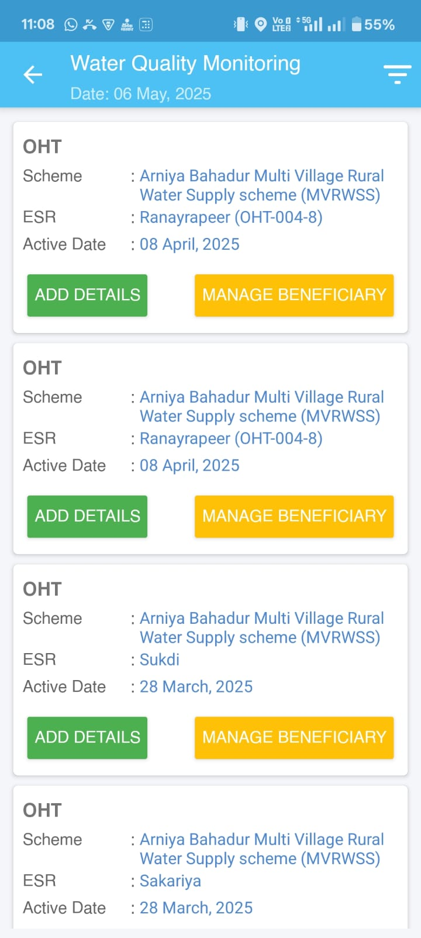
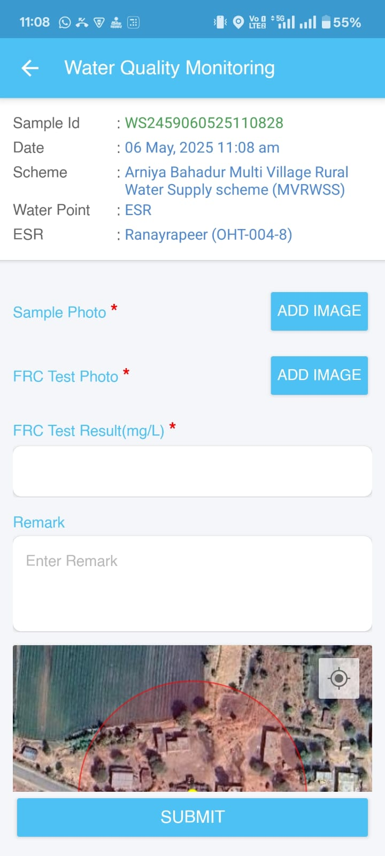
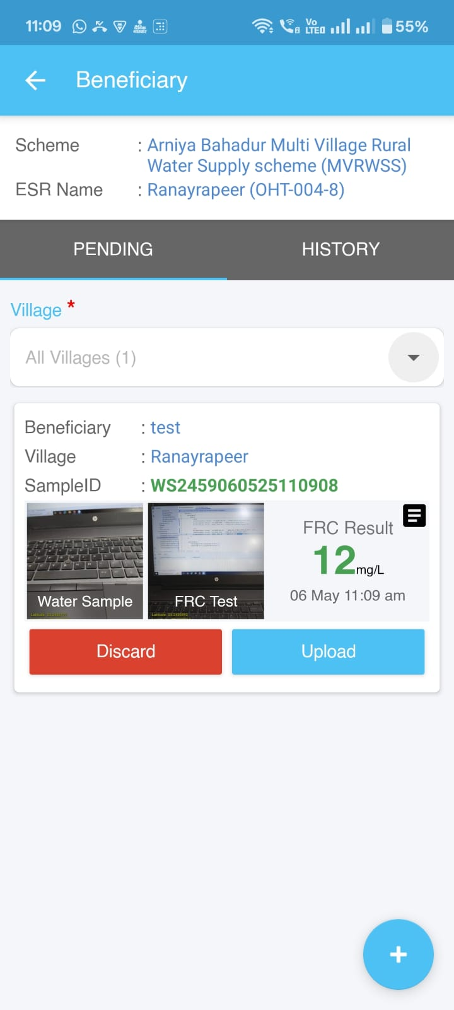
Jal Rekha Mobile Application – Nirmal
28

Slide 29
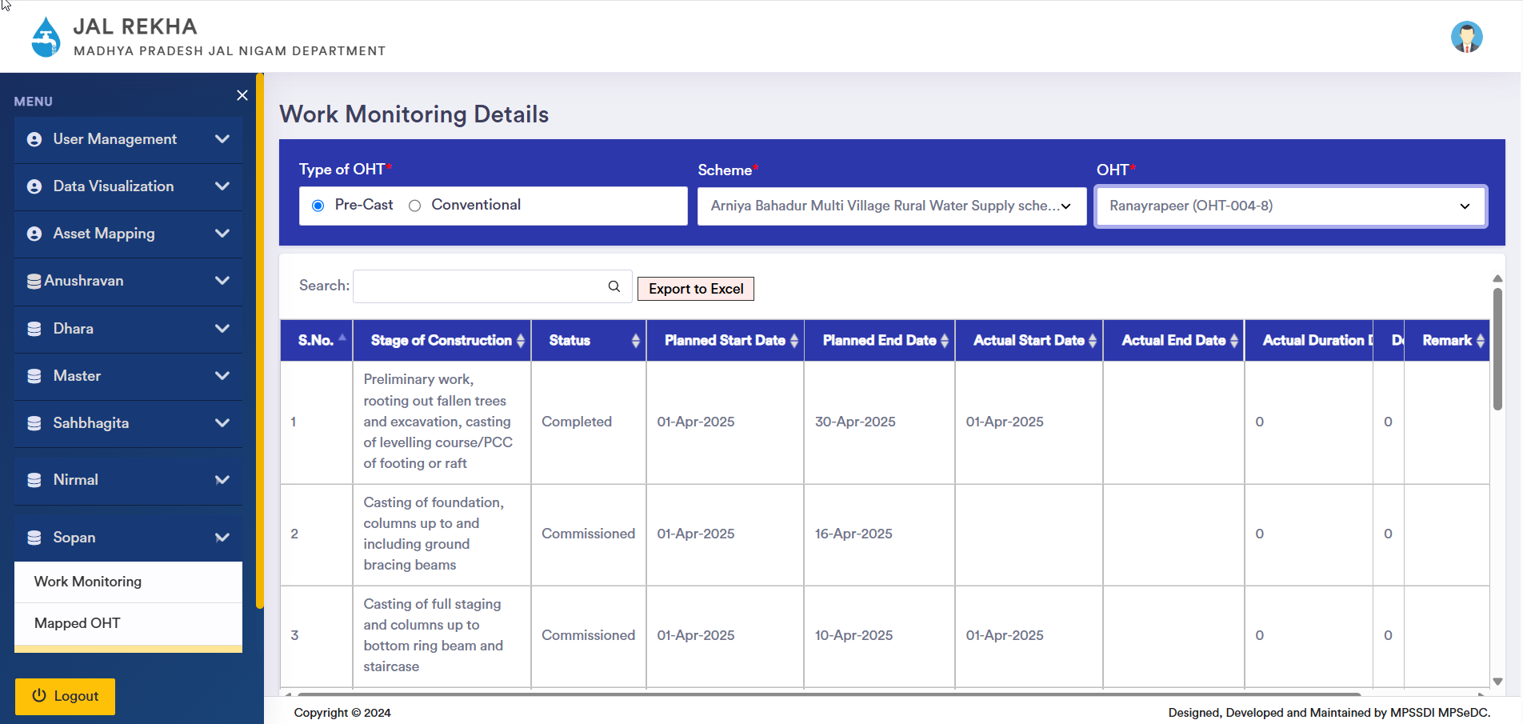
Jal Rekha – Sopan
Sopan -The Sopan module has been developed to streamline the process of capturing and monitoring contractors' commitments to the timely construction of overhead tanks (OHTs). Recognizing that delays and lingering by contractors were affecting project timelines, the department introduced this module to bring accountability, improve planning, and strengthen monitoring of construction works.
Contractor: The contractor selects the OHT from the dropdown, chooses the type of OHT (Pre-Cast or Conventional), and enters the planned start date and planned completion date .
General Manager (GM): The General Manager can review the details, upload documents, or add remarks if additional clarity is needed. The system will maintain a log of the communication between the GM and the contractor.

Slide 30

Jal Rekha – Dashboard

Slide 31

Jal Rekha – Dhara Dashboard

Slide 32


Thank You
OUR ADRESS
MPSEDC Ltd. State IT Centre, 47-A, Arera Hills, Bhopal-462011 (M.P.)
CONTACT
+91 755 2518300, +91 755 2518500
mpssdi@mp.gov.in

